Slide 1
Install Power BI
Install Power BI

Slide 2
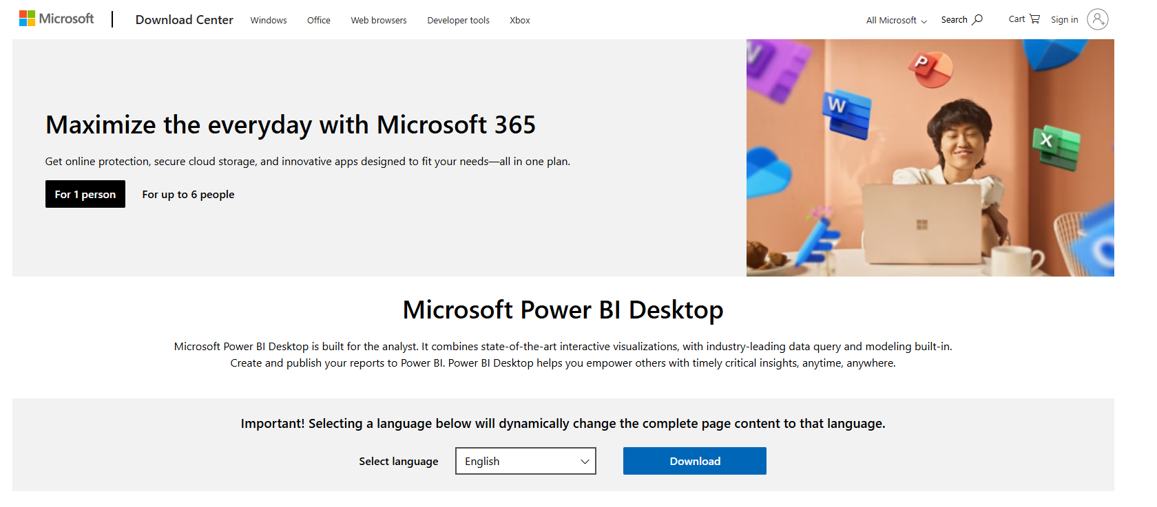
Power BI Elements

Slide 3
Thank you
Thank you

